Slide 1

A third person Dungeon Crawler Horror game by Group 18
Lourenço Soares
Diogo Sousa
Pedro Ribeiro
Notes:
Diogo

Slide 2
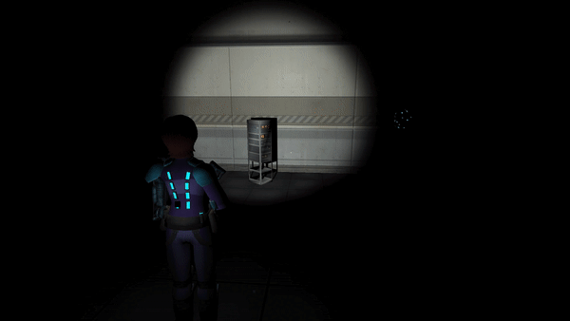
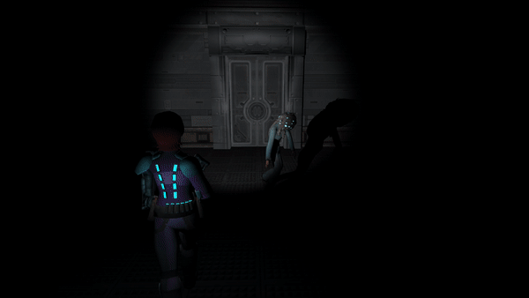
MECHANICS
Third person shooter
Dark, narrow field of vision
Must be aware of surroundings
Audio plays a big role
Risk ammo (noise) between the unkillable Hunter and weaker enemies.
Play for the high score by looting items, one life. Restarting is quick.
Levels are split by floors
Notes:
Pedro

Slide 3
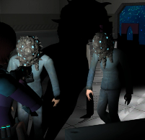
STORY
Skye Forager plunders a seemingly abandoned research vessel to find objects to sell.
Said research vessel is not abandoned, rather its crew has been converted by an unknown biomechanical entity.
Unfortunately, our plans for the story were scaled back due to time constraints
We intended to include collectible SD cards which would slowly reveal the story to the player.
Notes:
Lourenço

Slide 4
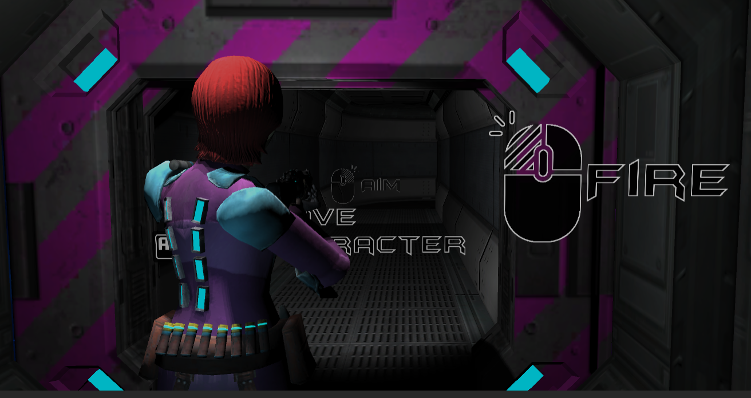
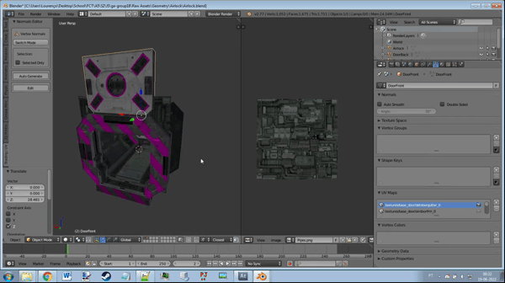
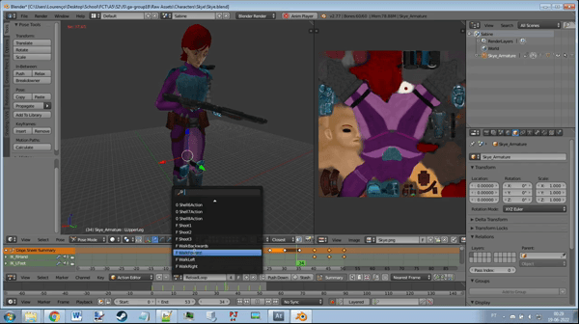
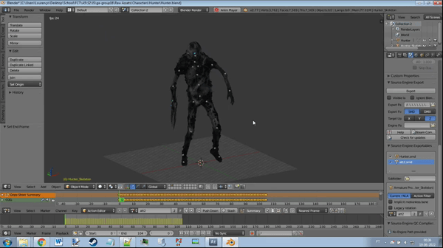
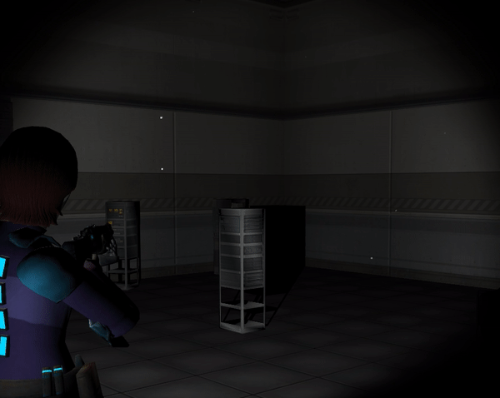
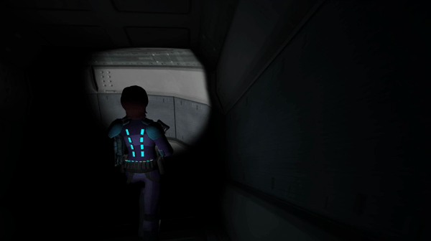
AESTHETHICS
Neon art style
No HUD, fully diegetic interface
Dark theme
Bump, Environment and Emission Maps
Custom character and environment models + animation
Dynamic lights and shadows
Particles
Dust and flickering lights
Muzzle Flash, Bullet Trails and Decals
Notes:
Diogo

Slide 5
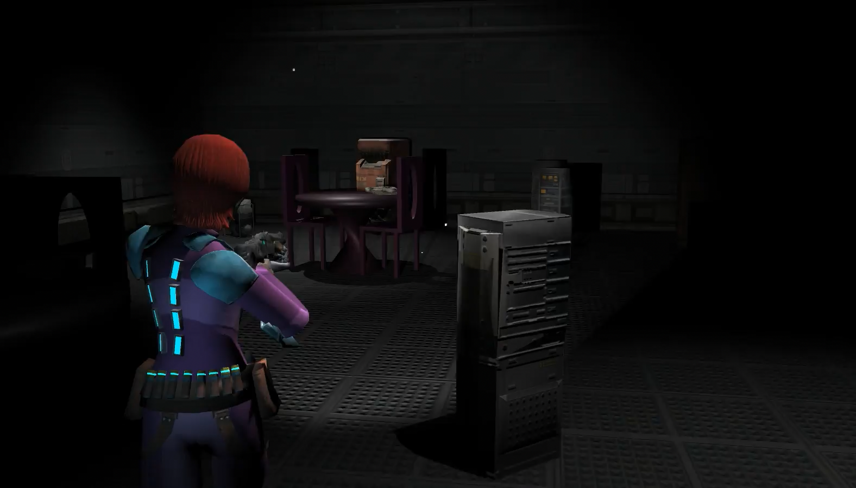
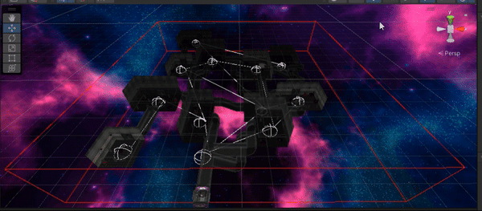
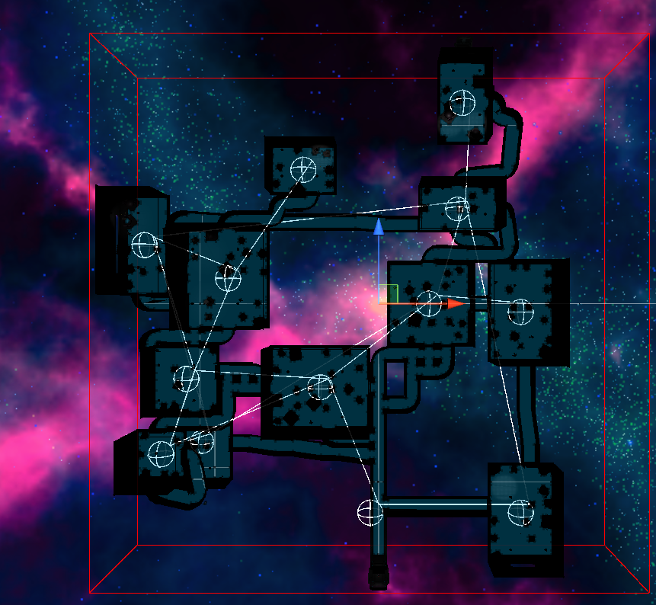
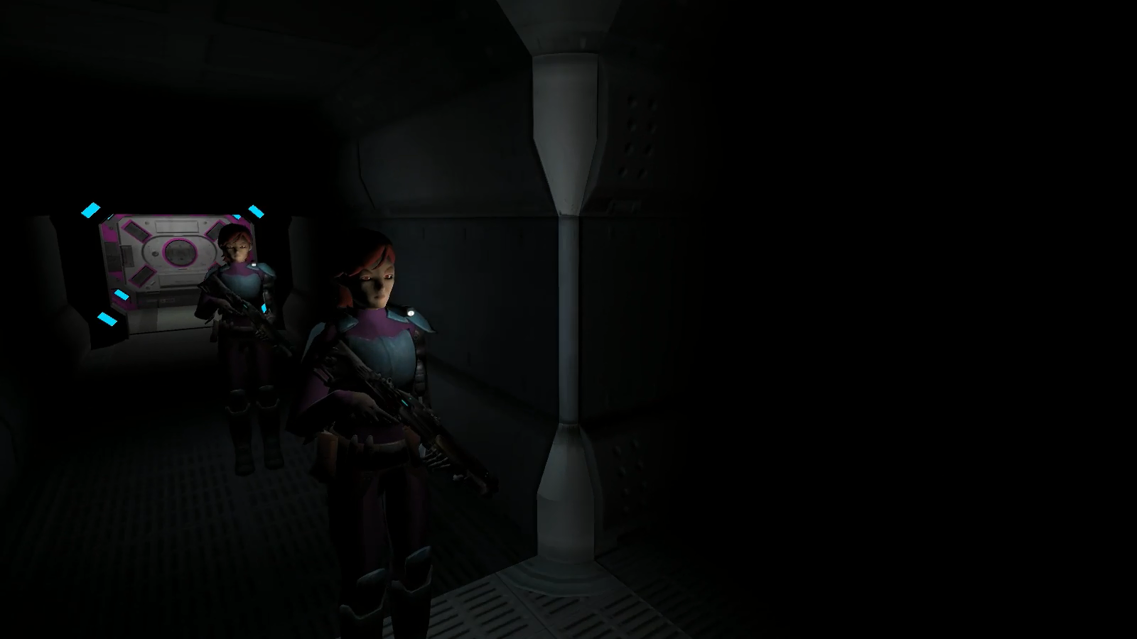
TECHNOLOGY
Procedural Generation
Procedural Audio
Multiplayer using Photon
Monster AI using navmesh
Visual Optimizer
Notes:
Lourenço

Slide 6
AUTO EVALUATION
Procedural Generation | Procedural Audio | Multiplayer
Very strong. (2.0) Fully 3D Can generate interesting layouts Could just use a bit more variation | Very strong (2.0) Custom low pass filter using OnAudioFilterRead Custom audio manager that applies effects based on the location of the player/enemies Adaptive music | Strong (1.7) Anyone can host a game from anywhere in the world and play together Could use a bit more work, but it works consistently.
Notes:
Pedro

